Slide 1

Java Swing Components – JTable
SWEN661 – Spring 2021
Debashis Jena

Slide 2
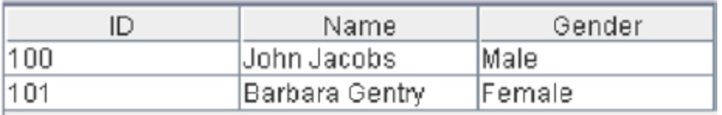
Basics
JTable is similar to the HTML tables.
They have rows and columns.
Column headers can be set as part of the JTable initialization properties.
JTable allows the users to sort the rows at the runtime.
JTable should not be confused as a table in the database or in the backend. It is simply a frontend component to display the data in tabular format.

Slide 3
Technical Details
JTable lives in javax.swing package.
It requires no-args constructor to initialize, however there are other constructors available too. JTable class implements the TableModelListener interface.
JTable can also be instantiated from DefaultTableModel, which is another implementation of TableModel.

Slide 4
Constructors
JTable table = new JTable(); - Empty table
JTable table = new JTable(rows, cols); - Initializes a table with rows and columns
JTable table = new JTable(Object[][] data, Object []Column); - Initializes with a two-dimensional data set and an array of column names.

Slide 5
Methods
addColumn(TableColumn aColumn) – Appends a column at the end of the table.
getColumnCount() – Returns the number of columns in the column model.
getRowCount()– Returns the number of rows that can be shown in the JTable, given unlimited space.
isCellEditable(int rowIndex, int columnIndex) – Returns true if the cell at row and column is editable. Otherwise, invoking setValueAt on the cell will have no effect.
getValueAt(int rowIndex, int columnIndex) – gets the value from specified row number and column number.
setValueAt(Object aValue, int row, int column) – Sets the value for the cell in the table model at row and column.

Slide 6
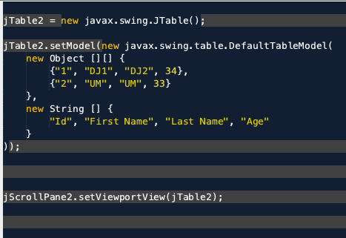
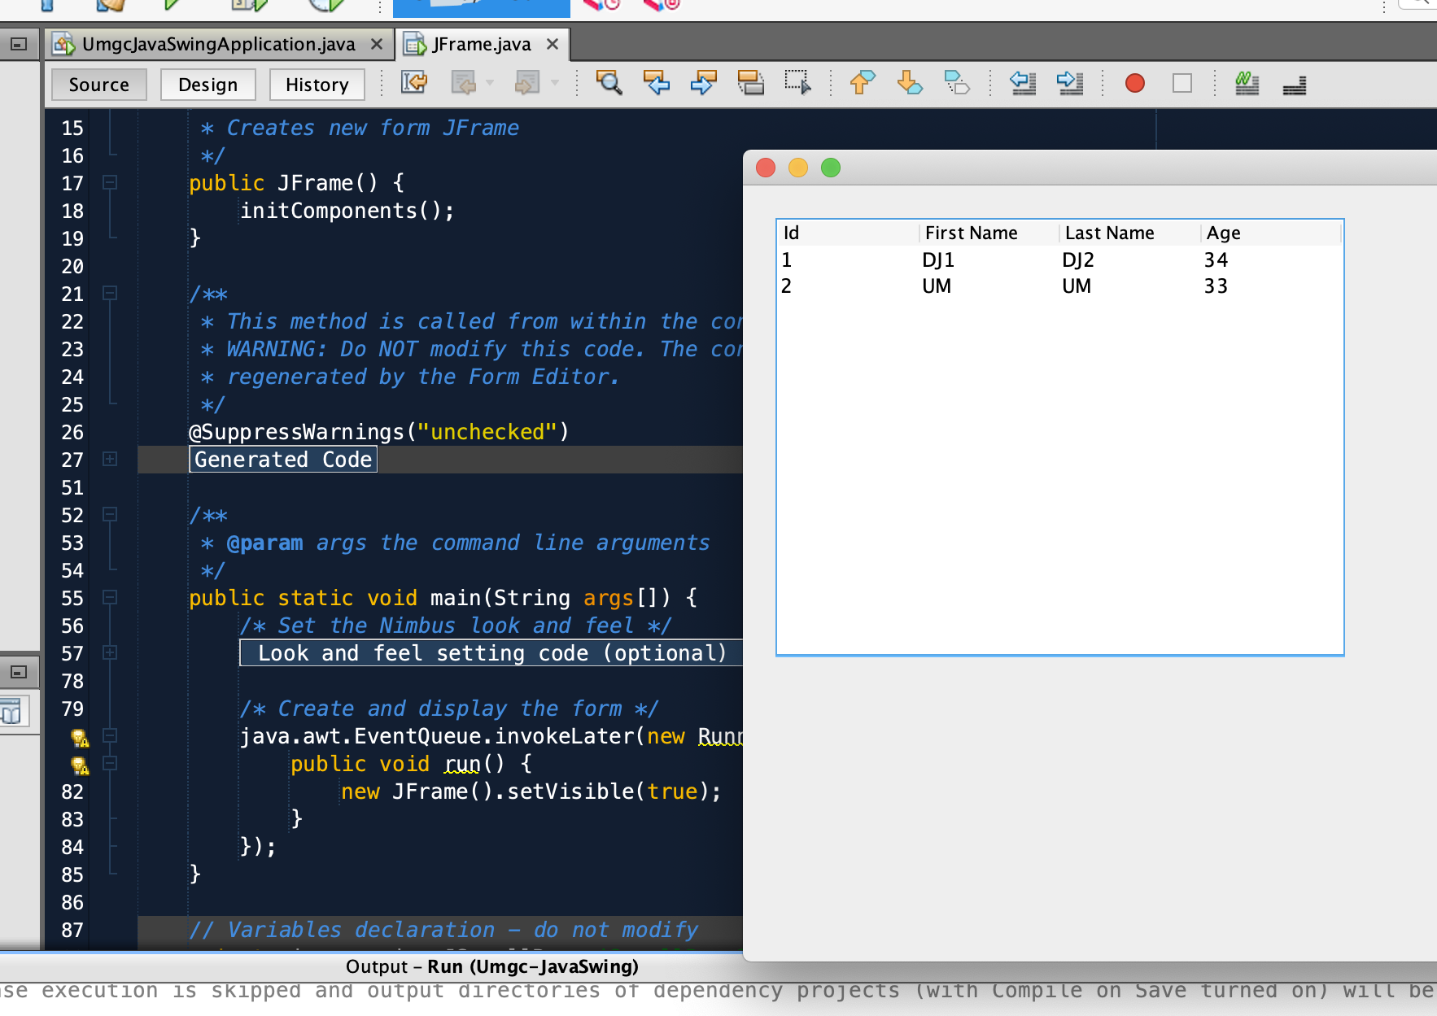
Page and Source Code

Slide 7
Reference
Sharan, K. (2014). Beginning java 8 apis, extensions and libraries: swing, javafx, javascript, jdbc and network programming apis. Retrieved from http://library.books24x7.com.ezproxy.umgc.edu/toc.aspx?bookid=72590.
Shivam, K. (2018). Java swing | Jtable. Retrieved from https://www.geeksforgeeks.org/java-swing-jtable/.

